Slide 1
A Circle Property
Risp 9

Slide 2
A Circle Property
I'm going to pick a number, let's say... 12.
Pick four numbers, any numbers, let's call them p, q, s, and t, where:
p and q multiply to 12, and
s and t multiply to -12.
Now create the points (p, s) and (q, t).
Record your values in a table to avoid confusion.

Slide 3
p | q | product | s | t | product
 |  | 12 |  |  | -12
( p , | s ) | ( q , | t )
A
B
Now on axes, plot the points A and B.
Using compasses, draw the circle that has AB as diameter.
What is the equation of your circle?
Do you notice anything unusual about your circle?
Compare your circle with those your colleagues have drawn.
What do they all have in common?

Slide 4
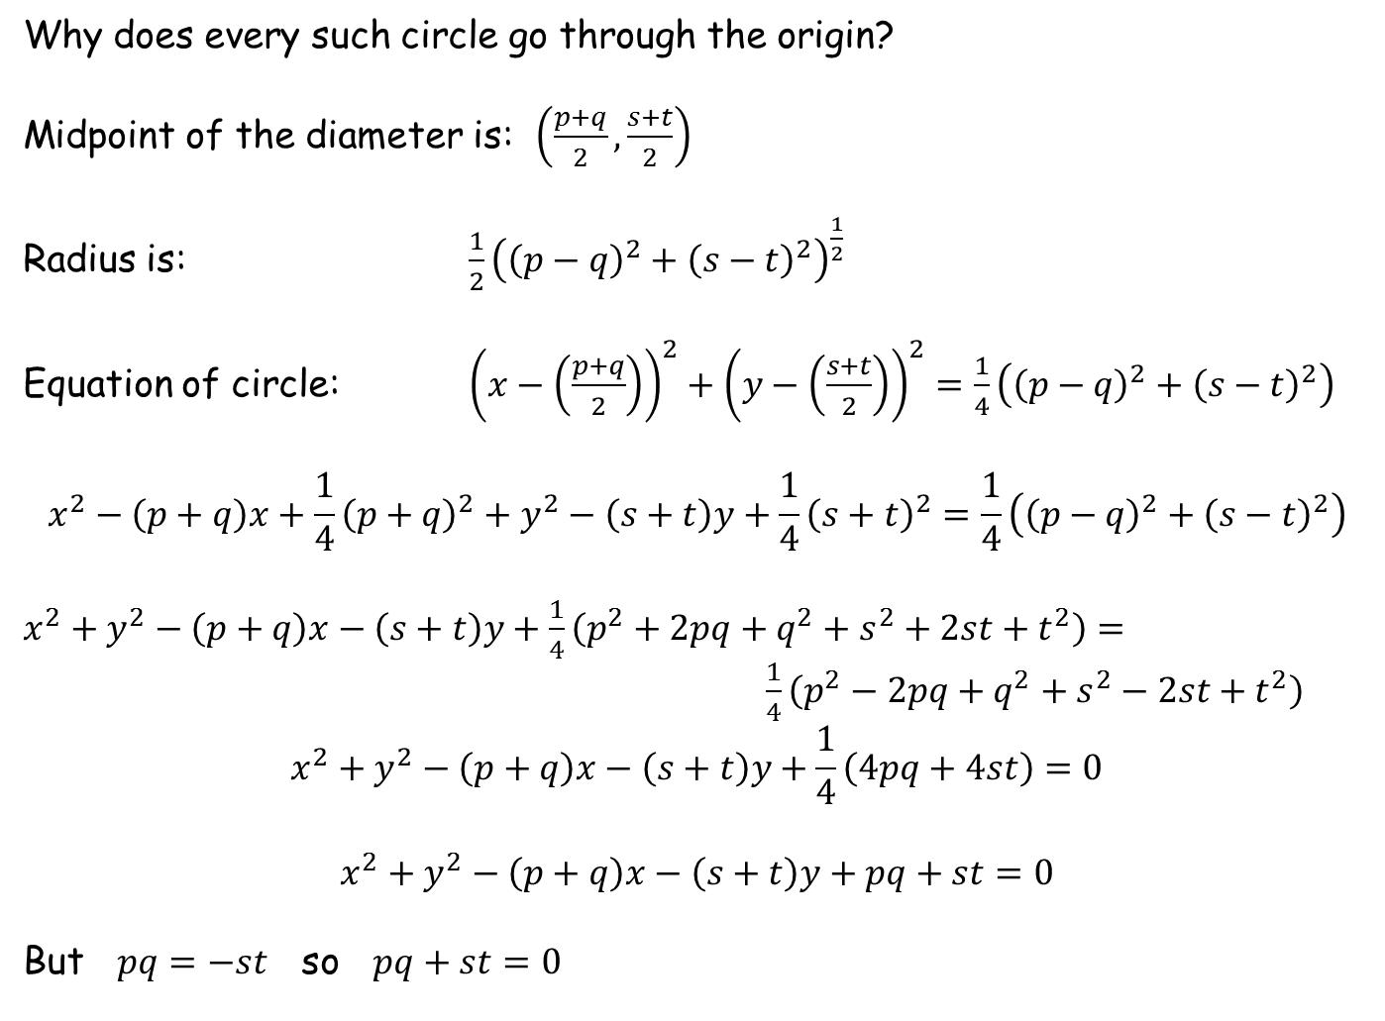
Why does every such circle go through the origin?
Midpoint of the diameter is: $\left(\frac{p+q}{2},\frac{s+t}{2}\right)$
Radius is: $\frac{1}{2}{\left({\left(p−q\right)}^{2}+{\left(s−t\right)}^{2}\right)}^{\frac{1}{2}}$
Equation of circle: ${\left(x−\left(\frac{p+q}{2}\right)\right)}^{2}+{\left(y−\left(\frac{s+t}{2}\right)\right)}^{2}=\frac{1}{4}\left({\left(p−q\right)}^{2}+{\left(s−t\right)}^{2}\right)$
$$x^{2}−\left(p+q\right)x+\frac{1}{4}{\left(p+q\right)}^{2}+y^{2}−\left(s+t\right)y+\frac{1}{4}{\left(s+t\right)}^{2}=\frac{1}{4}\left({\left(p−q\right)}^{2}+{\left(s−t\right)}^{2}\right)$$
$x^{2}+y^{2}−\left(p+q\right)x−\left(s+t\right)y+\frac{1}{4}\left(p^{2}+2pq+q^{2}+s^{2}+2st+t^{2}\right)=$
$\frac{1}{4}\left(p^{2}−2pq+q^{2}+s^{2}−2st+t^{2}\right)$
$$x^{2}+y^{2}−\left(p+q\right)x−\left(s+t\right)y+\frac{1}{4}\left(4pq+4st\right)=0$$
$$x^{2}+y^{2}−\left(p+q\right)x−\left(s+t\right)y+pq+st=0$$
But $pq=−st$ so $pq+st=0$

Slide 5
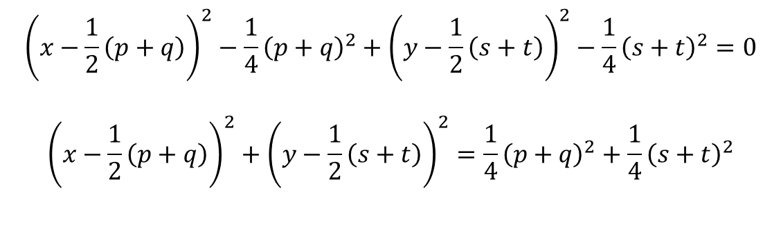
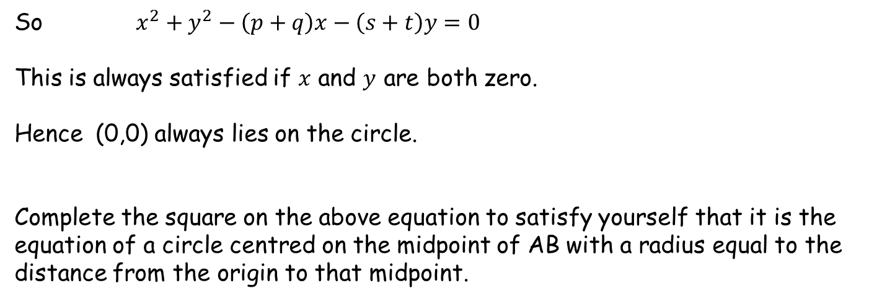
So $x^{2}+y^{2}−\left(p+q\right)x−\left(s+t\right)y=0$
This is always satisfied if $x$ and $y$ are both zero.
Hence (0,0) always lies on the circle.
Complete the square on the above equation to satisfy yourself that it is the equation of a circle centred on the midpoint of AB with a radius equal to the distance from the origin to that midpoint.
$${\left(x−\frac{1}{2}\left(p+q\right)\right)}^{2}−\frac{1}{4}{\left(p+q\right)}^{2}+{\left(y−\frac{1}{2}\left(s+t\right)\right)}^{2}−\frac{1}{4}{\left(s+t\right)}^{2}=0$$
$${\left(x−\frac{1}{2}\left(p+q\right)\right)}^{2}+{\left(y−\frac{1}{2}\left(s+t\right)\right)}^{2}=\frac{1}{4}{\left(p+q\right)}^{2}+\frac{1}{4}{\left(s+t\right)}^{2}$$

Slide 6
So $x^{2}+y^{2}−\left(p+q\right)x−\left(s+t\right)y=0$
This is always satisfied if $x$ and $y$ are both zero.
Hence (0,0) always lies on the circle.
Complete the square on the above equation to satisfy yourself that it is the equation of a circle centred on the midpoint of AB with a radius equal to the distance from the origin to that midpoint.
$${\left(x−\frac{1}{2}\left(p+q\right)\right)}^{2}−\frac{1}{4}{\left(p+q\right)}^{2}+{\left(y−\frac{1}{2}\left(s+t\right)\right)}^{2}−\frac{1}{4}{\left(s+t\right)}^{2}=0$$
$${\left(x−\frac{1}{2}\left(p+q\right)\right)}^{2}+{\left(y−\frac{1}{2}\left(s+t\right)\right)}^{2}=\frac{1}{4}{\left(p+q\right)}^{2}+\frac{1}{4}{\left(s+t\right)}^{2}$$

Slide 7
Resources

Slide 8
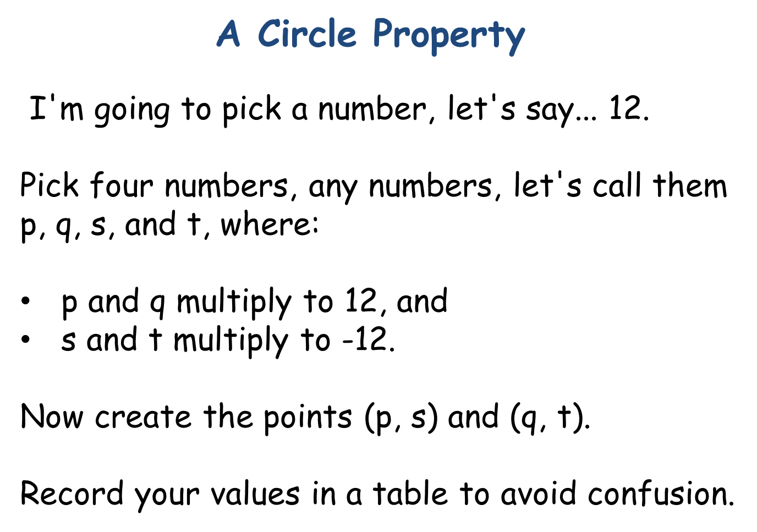
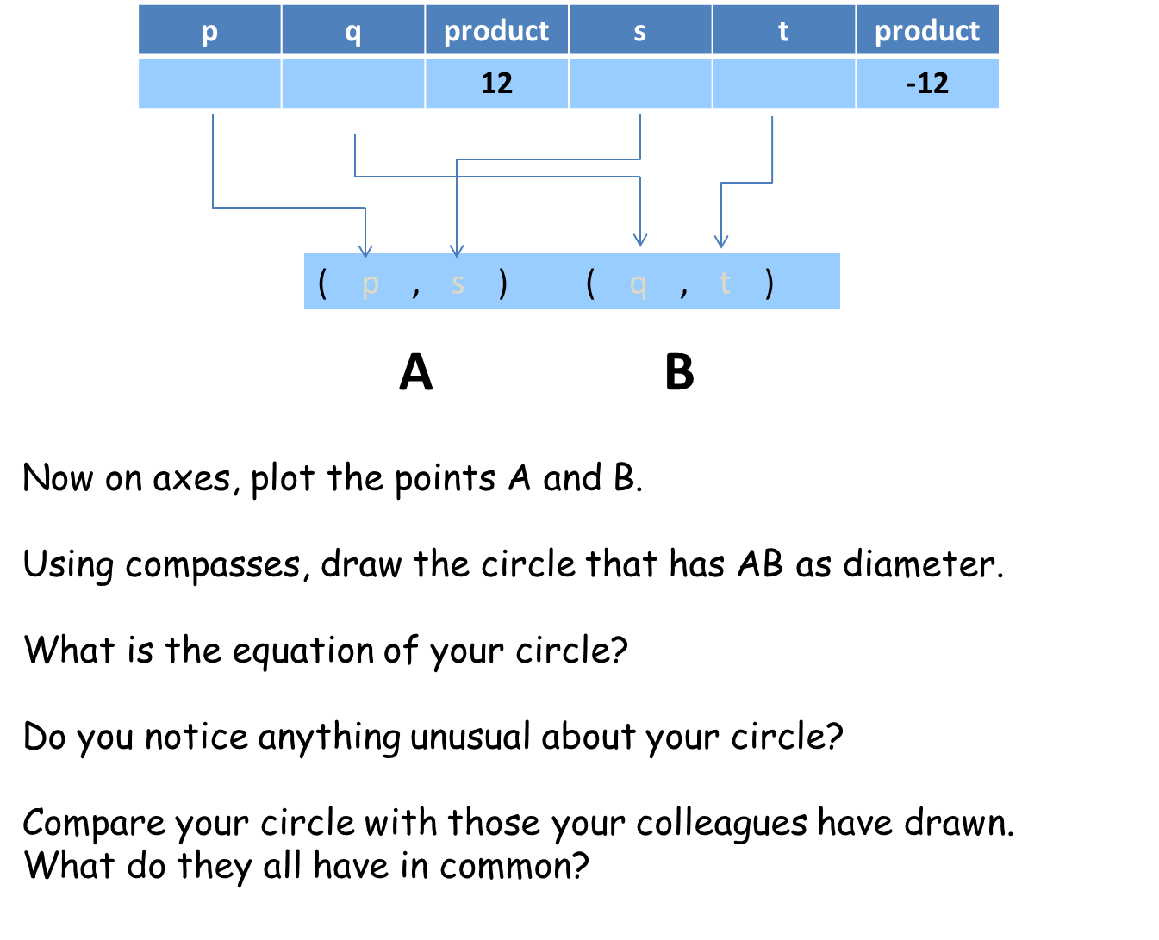
SIC_5
SIC_5

